Slide 1

IoT Fleet Management with balenaCloud

Slide 2
A Quick Tour

Slide 3
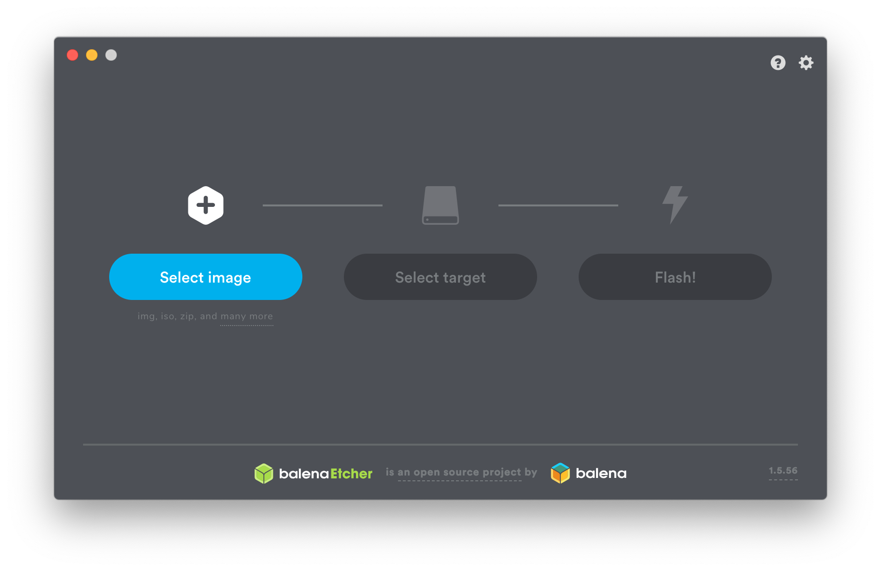
Notes:
I suspect there are some Etcher users in the audience.

Slide 4
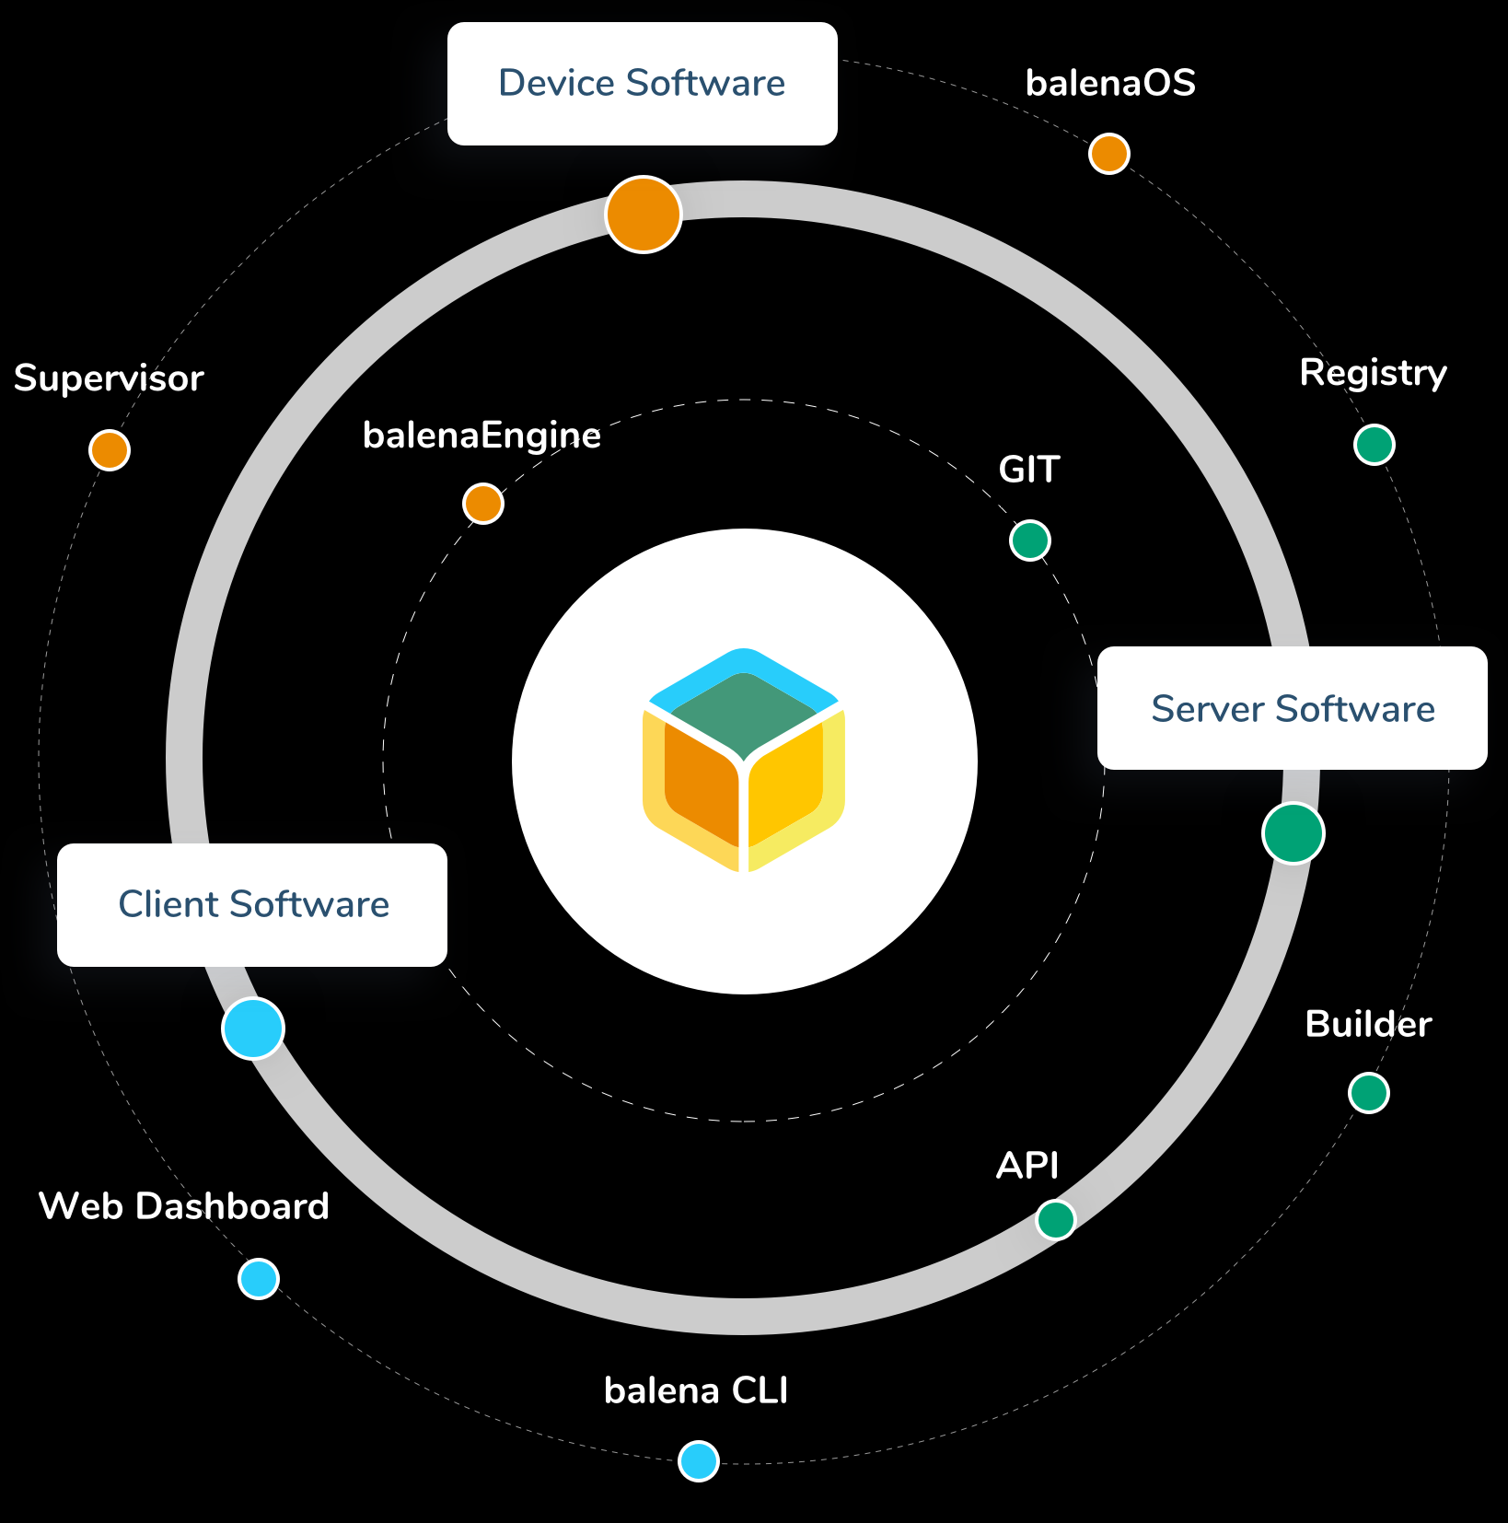
The Balena Ecosystem is Much More...
balenaCloud
balenaHub
balenaFin
EtcherPro
openBalena
balenaEngine
balenaOS
balenaLabs

Slide 5
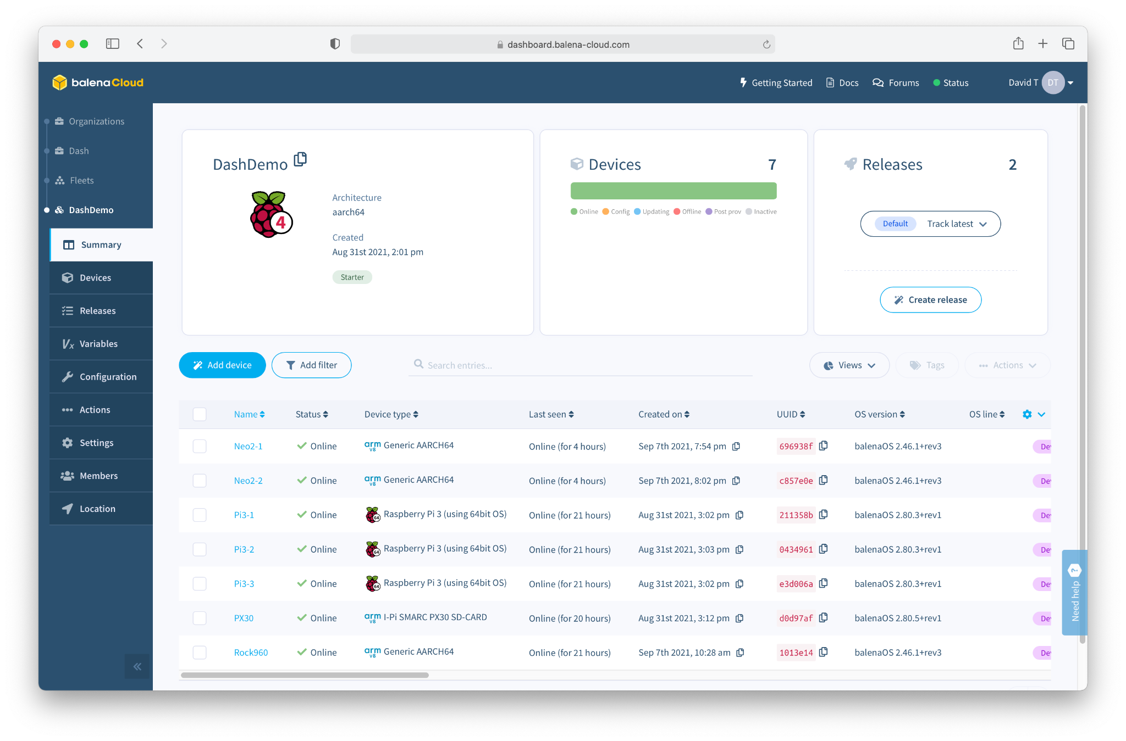
balenaCloud
“Platform built to develop, deploy, and manage fleets of connected devices at scale.”

Slide 6
What do we mean by IoT “Fleet Management”?

Slide 7
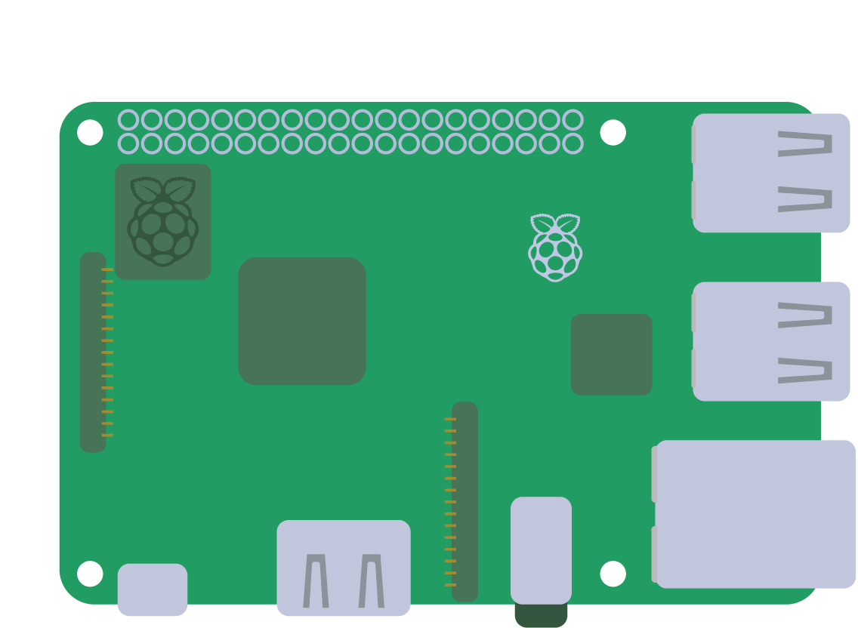


Slide 8
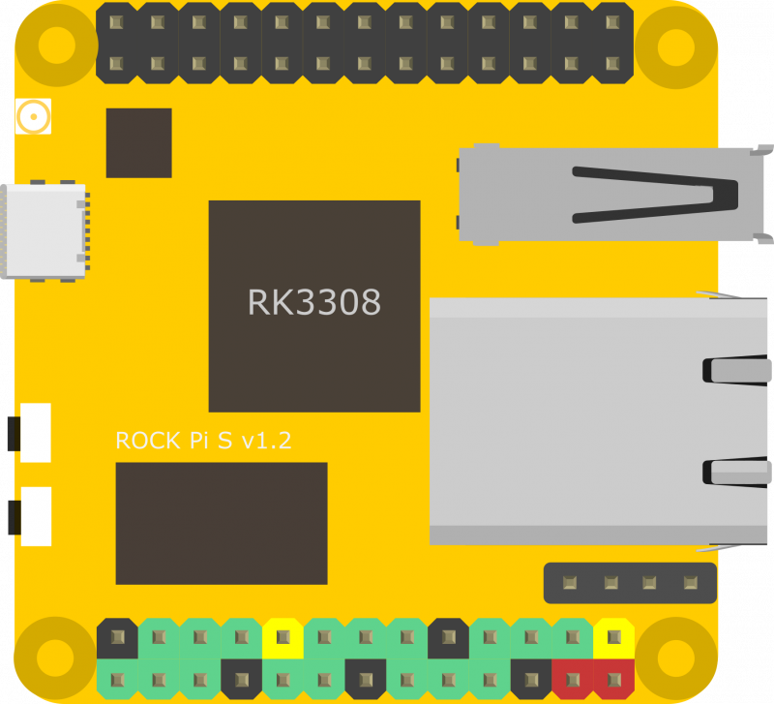
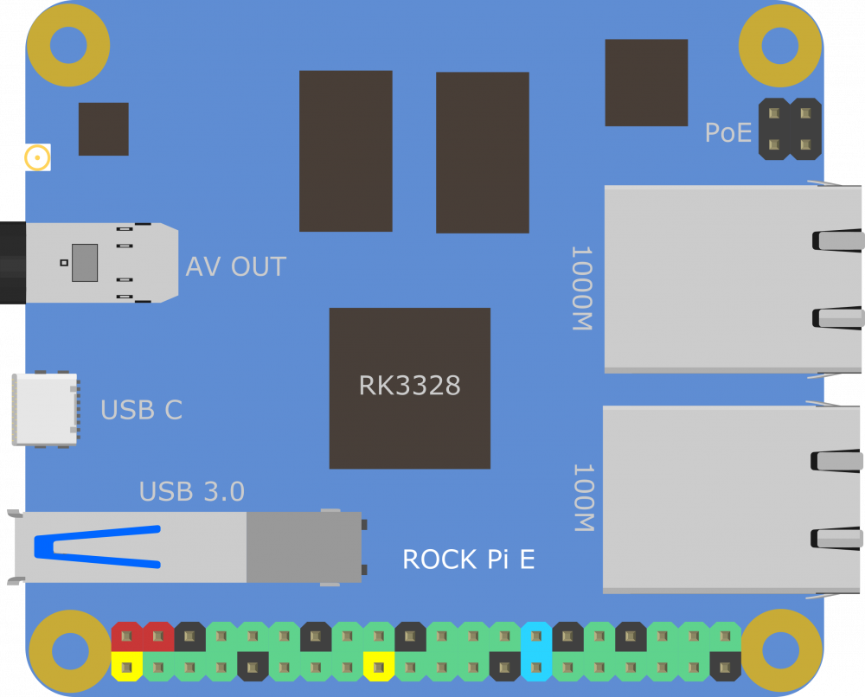
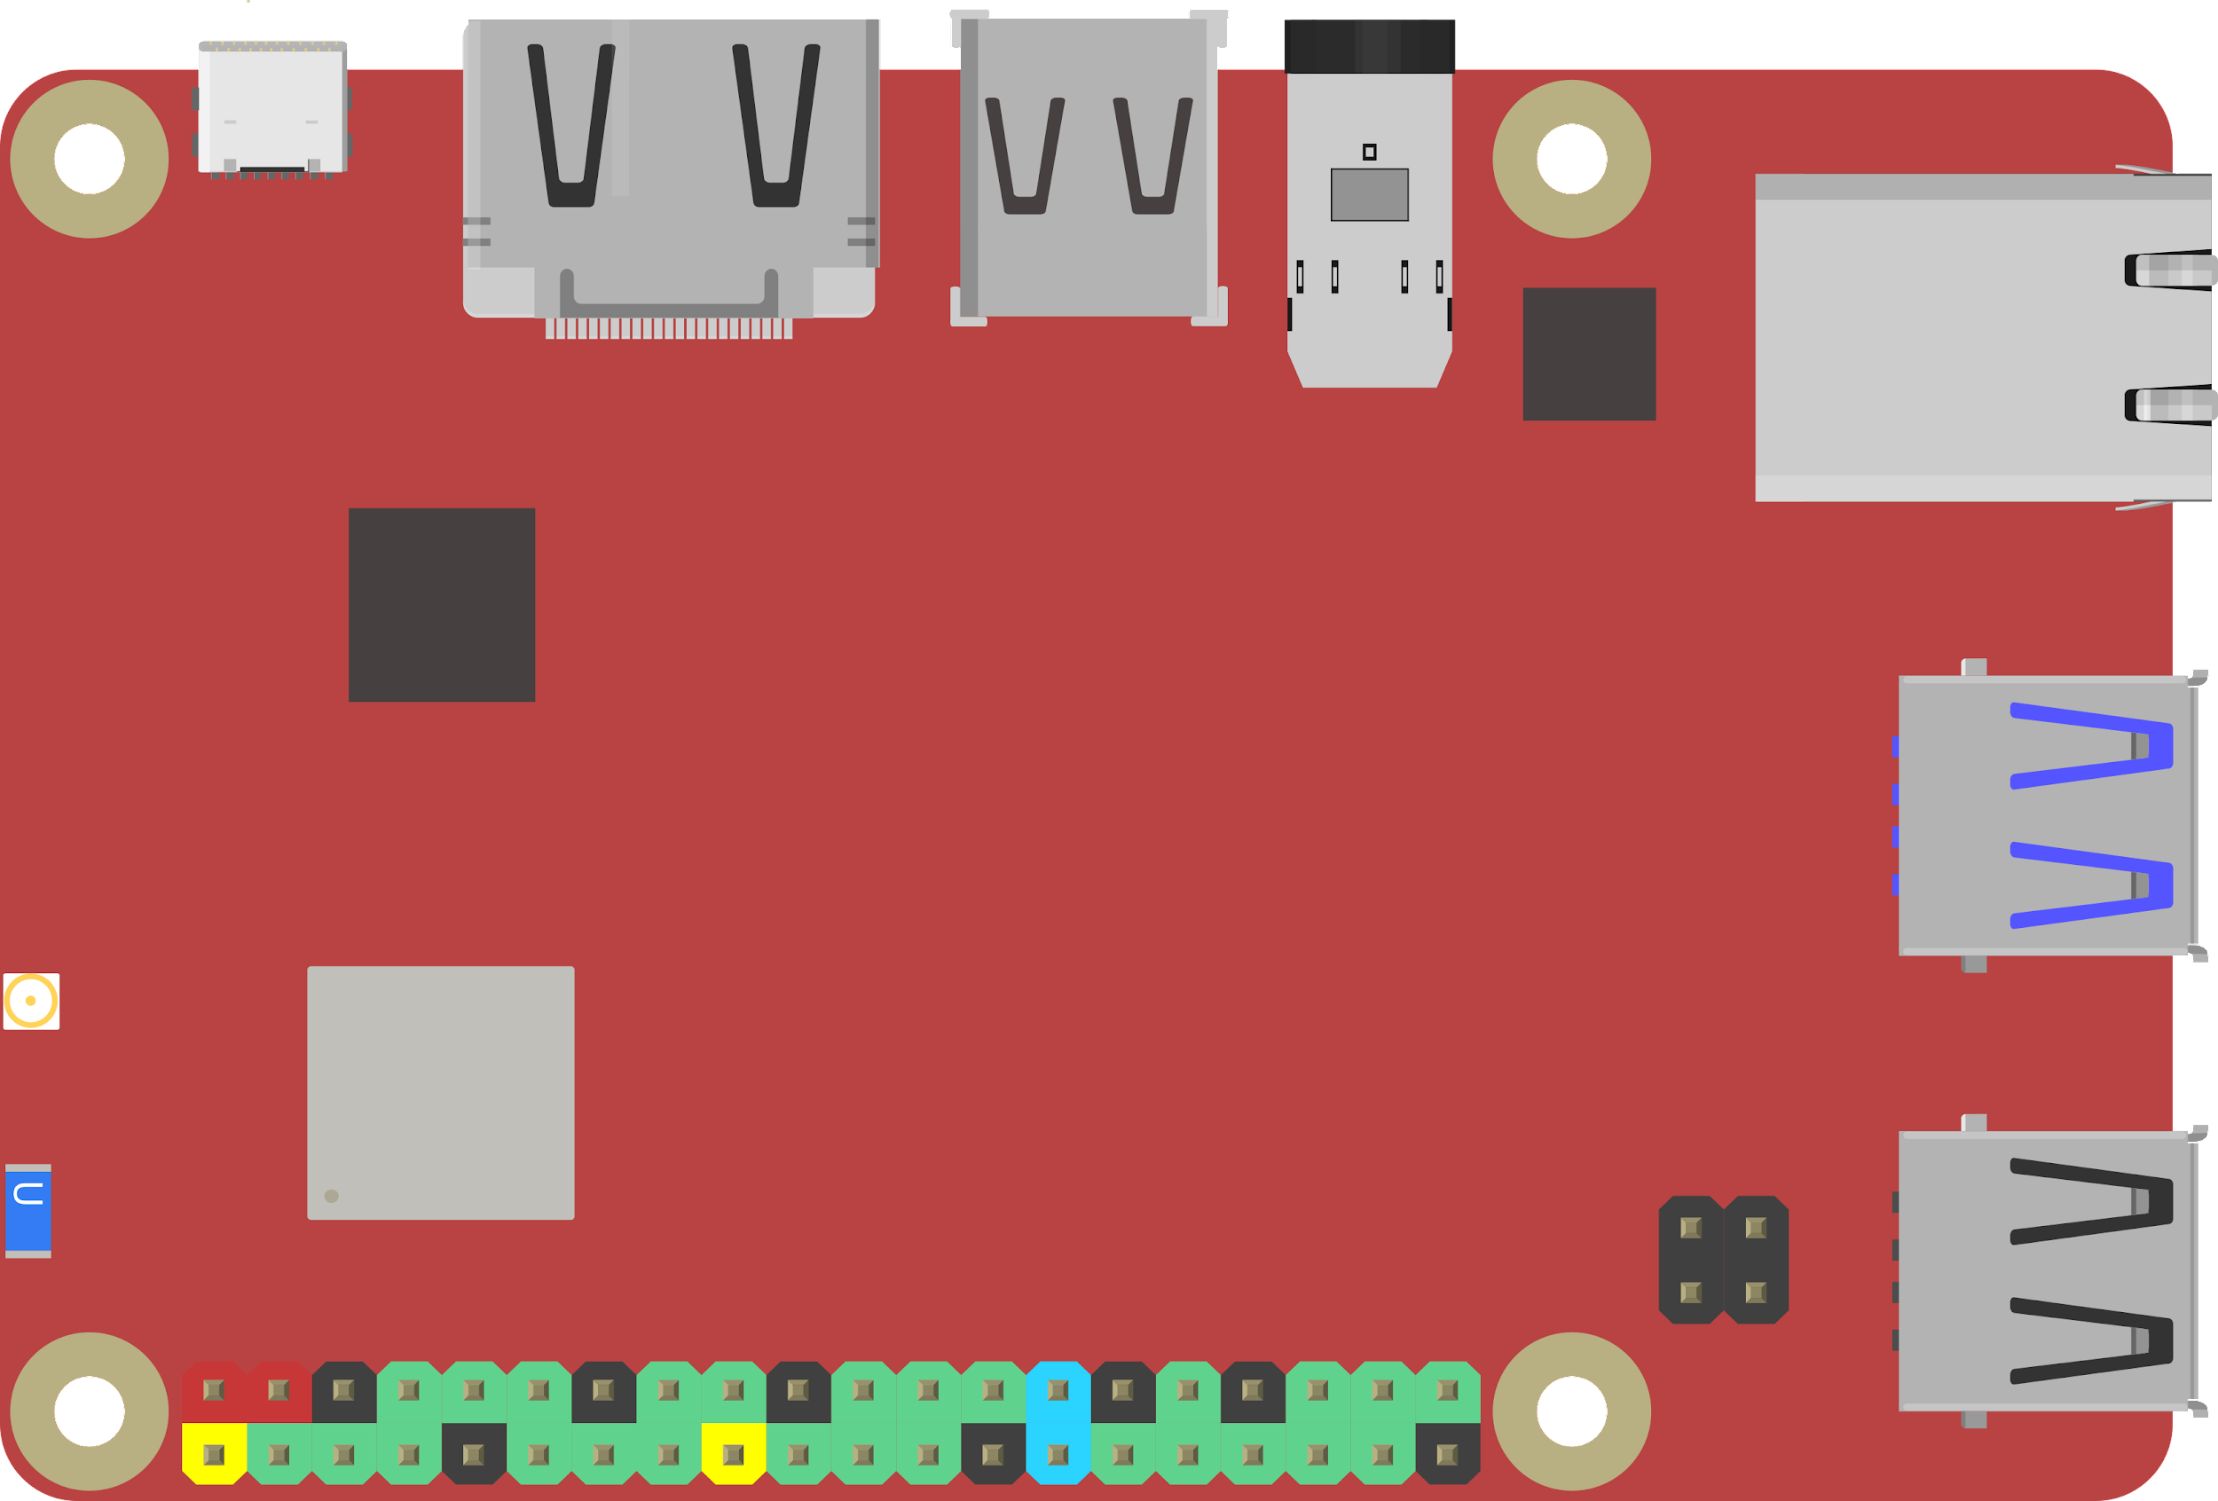
Notes:
48

Slide 10
Deploying a Device is Easy

Slide 11
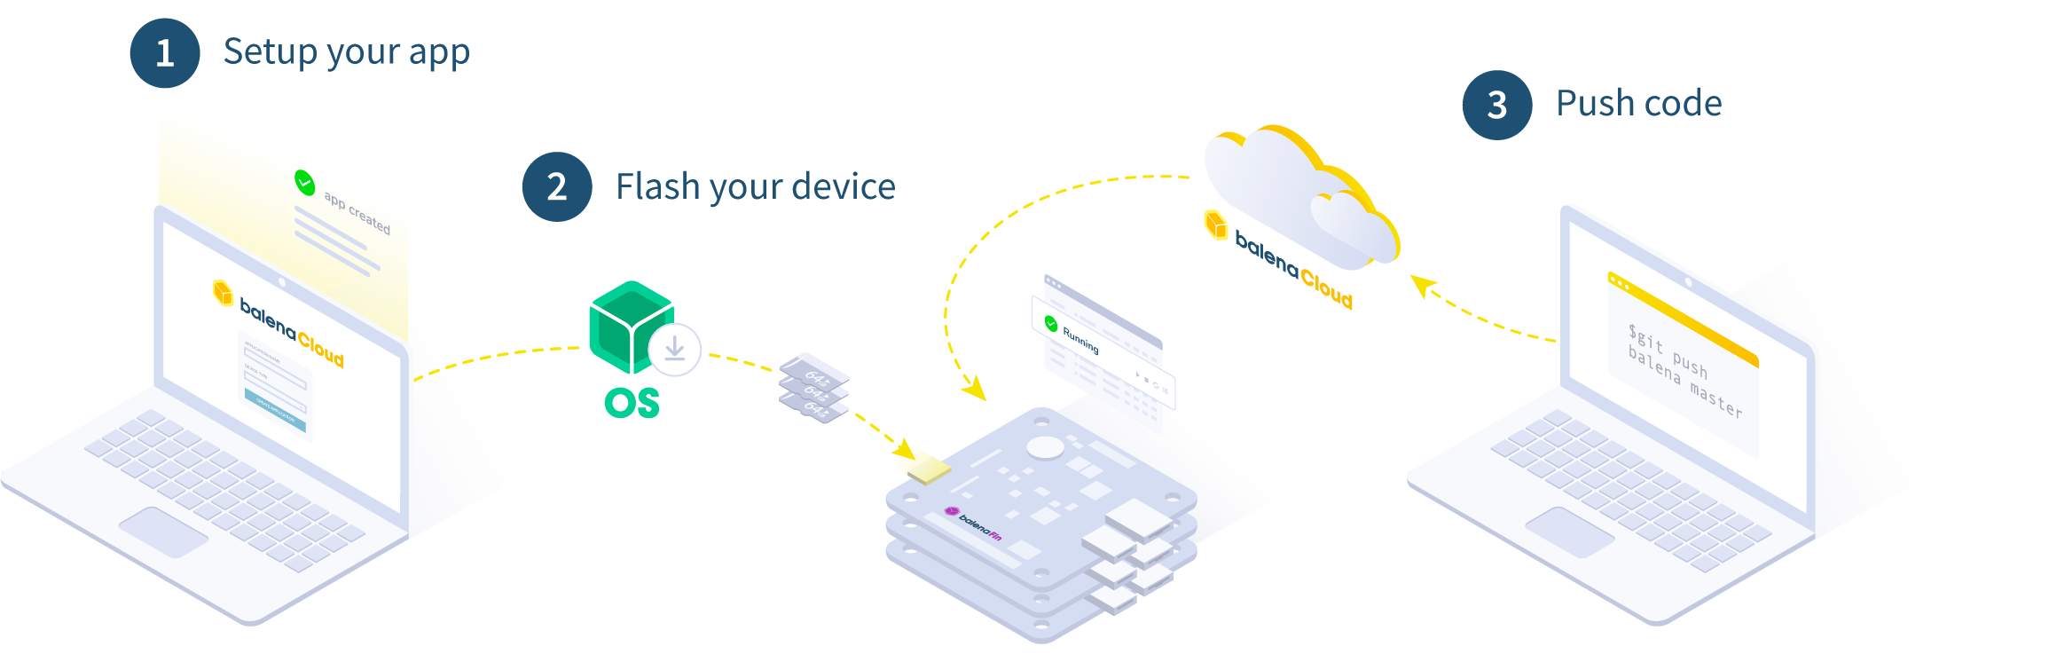
How it works

Slide 12
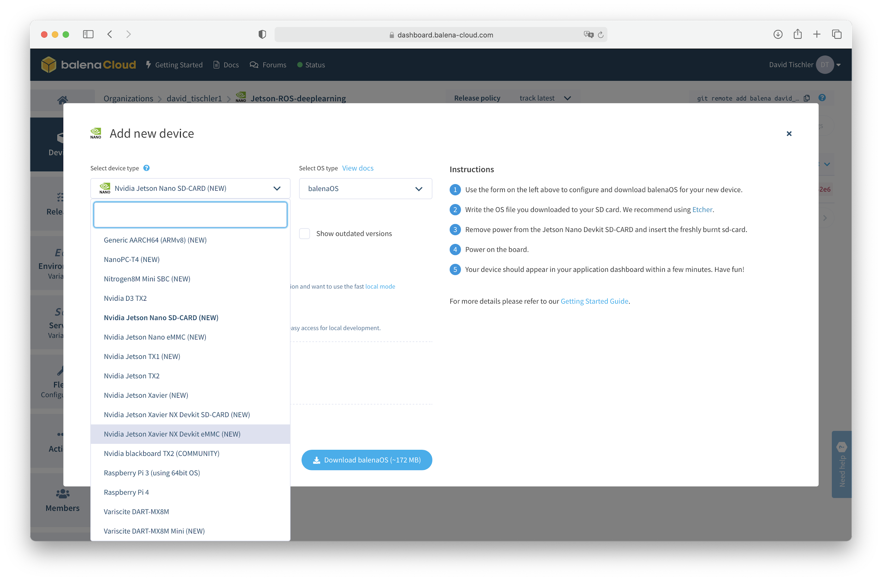

Slide 13
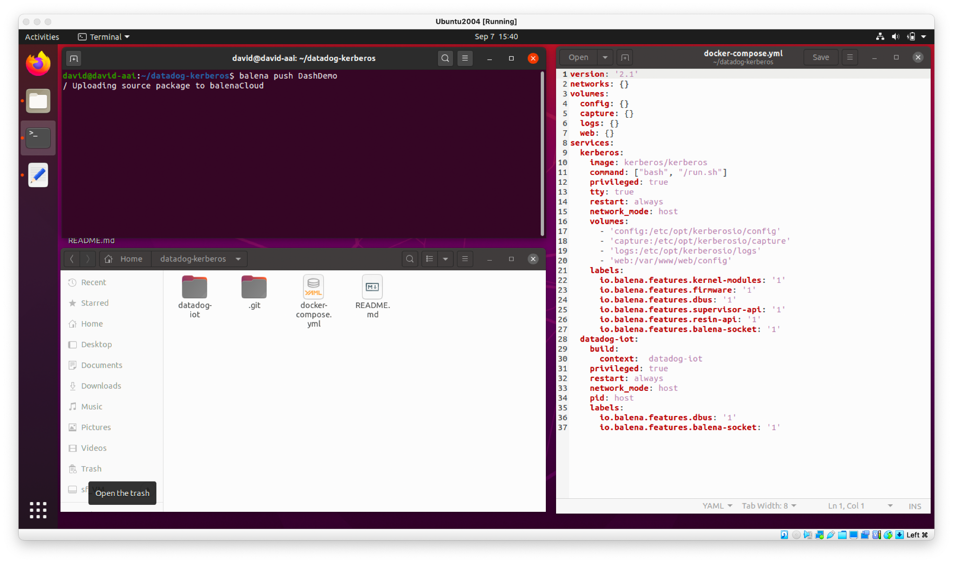
Build and Push Application to Fleet
Use balena CLI to package up application

Slide 14
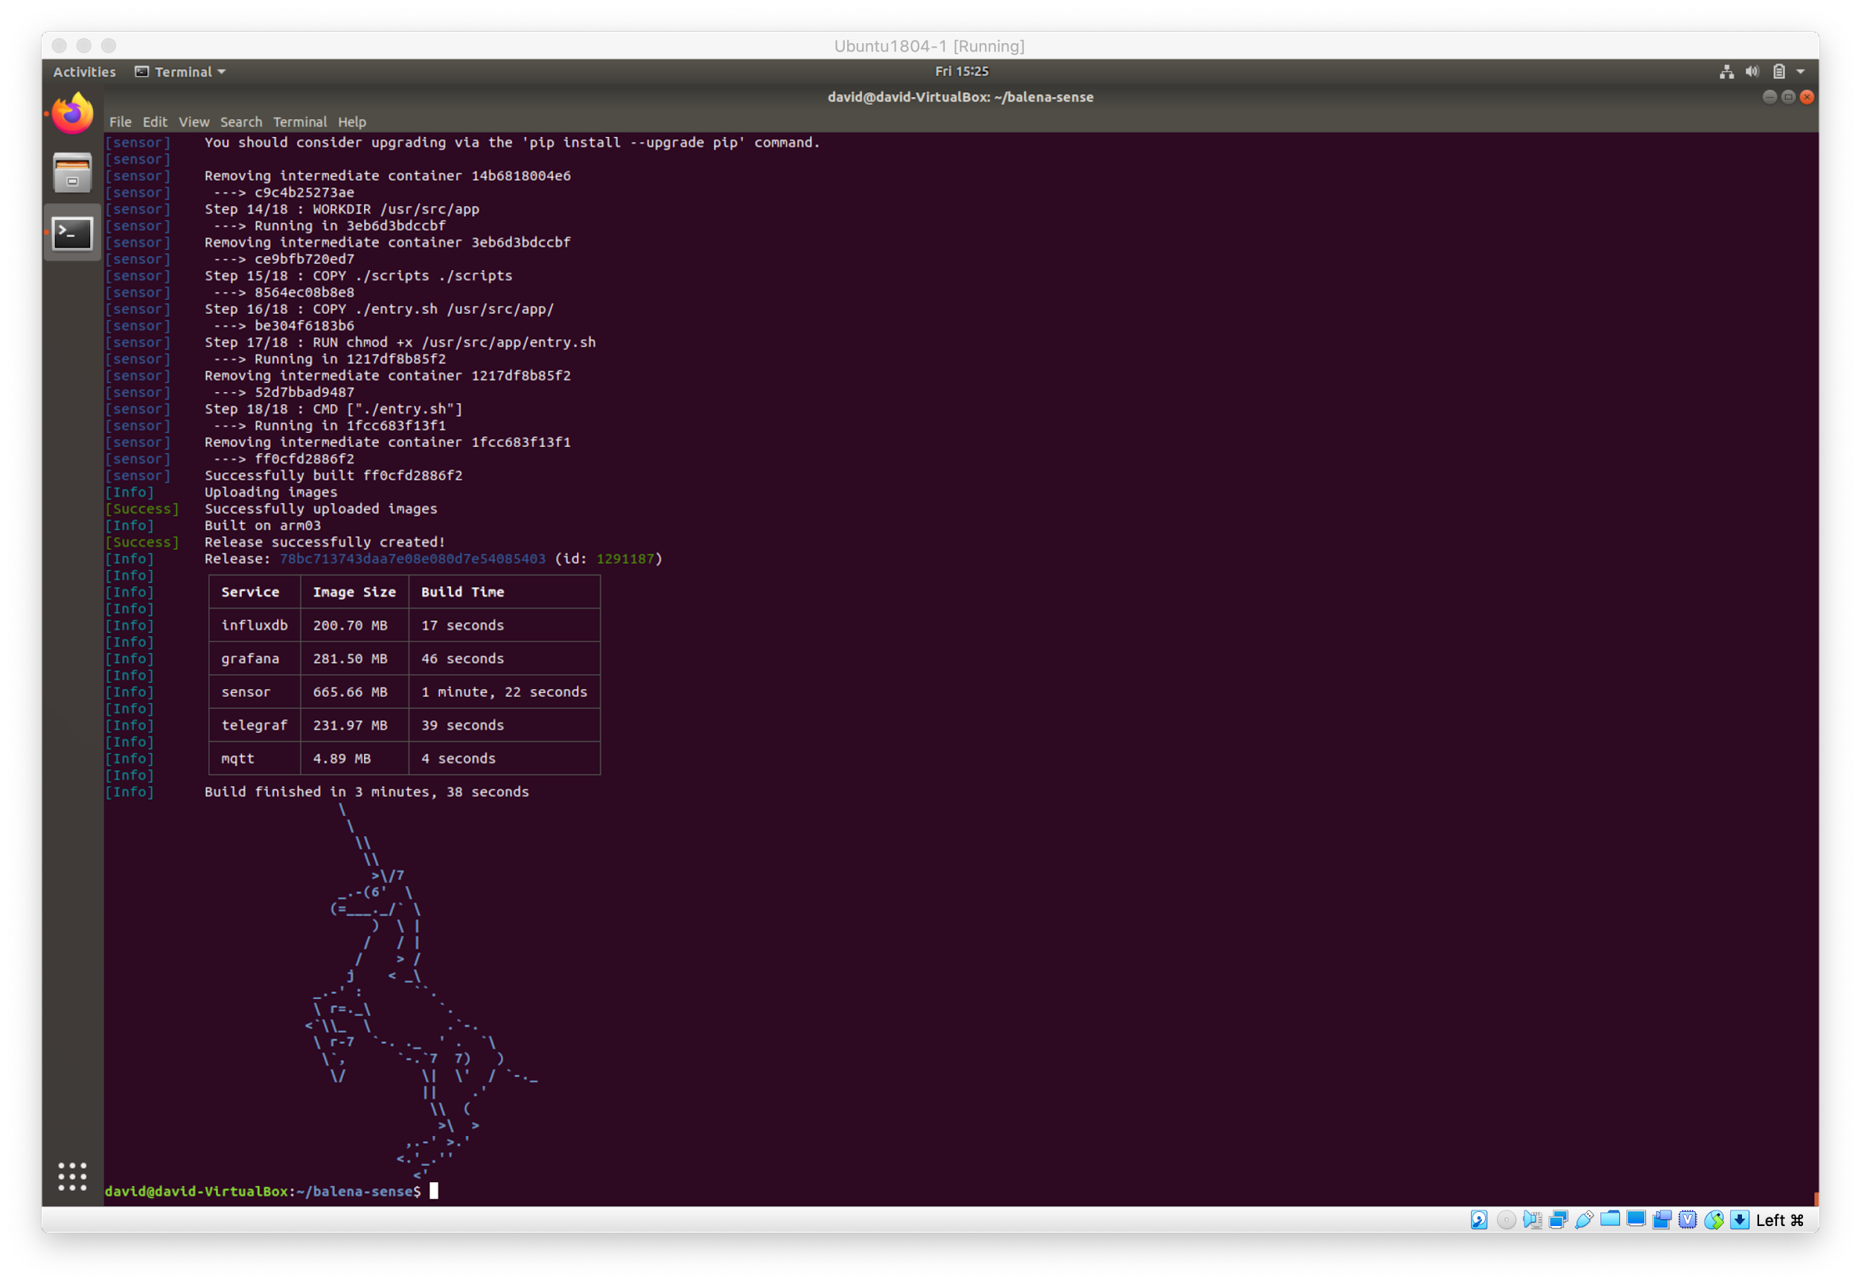
Build and Push Application to Fleet

Slide 15
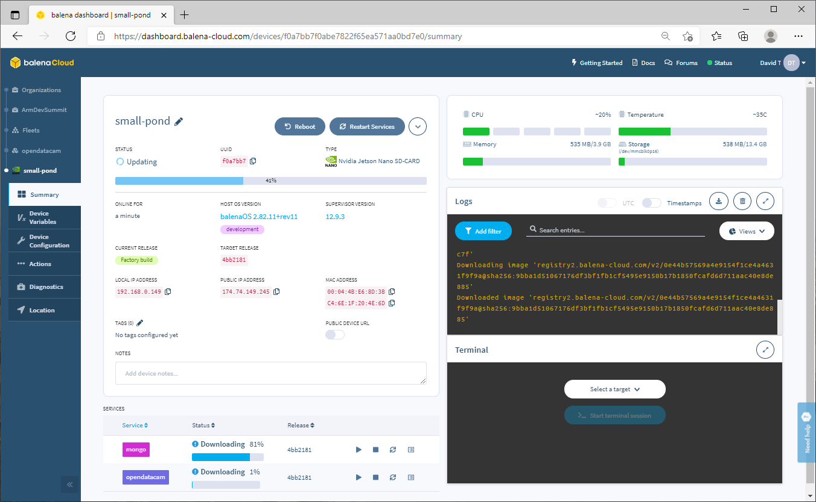

Slide 16
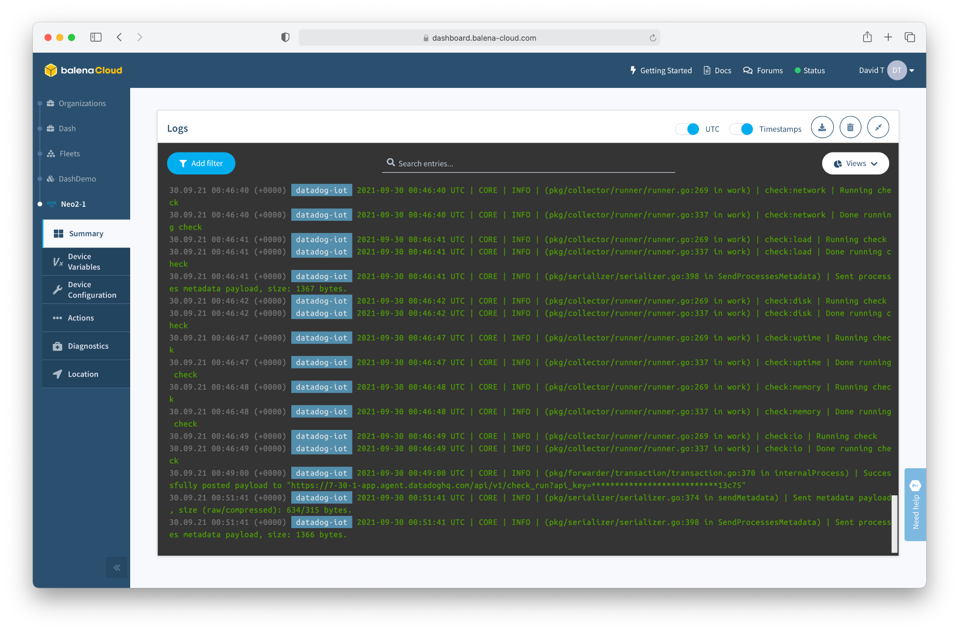

Slide 17
Keep Flashing Devices, and Build a Fleet

Slide 18
Things to try
http://hub.balena.io
http://balena.io/blog
http://github.com/balenalabs
Edge Impulse
Nvidia Jetson
ROS
Display, Signage, Kiosk
Environmental Sensing
OpenDataCam (Jetson Nano)
LoRa Gateways (TTN, Helium)
…. and more

Slide 19
Questions / Q&A

